Slide 2
conversion
Acts 3:11-21

Slide 3
Great commission
Matthew 28:18-20
Mark 16:15,16

Slide 4
The essence if the commission is:
HEAR THE WORD – Romans 10:17 “faith comes by hearing”
  Romans 10:14 – Today HEAR by READING
BELIEVE – John 8:24 “if you do not believe that I am, you will die in your sins." Hebrews 11:6 “ without faith {it is} impossible to please {God}”
REPENT – Acts 17:30 “(God) commands all men everywhere to repent."
CONFESS CHRIST AS LORD – Romans 10:10 “with the mouth confession is made to salvation." Matthew 10:32,33
BAPTIZED- 1 Peter 3:21 “an antitype which now saves us, {namely} baptism (not the removal of the filth of the flesh, but the answer of a good conscience toward God), through the resurrection of Jesus Christ."

Slide 5
What is “baptism?”
Romans 6:3,4
Baptism describes an IMMERSION in water!

Slide 6
Saved!
Acts 4:12
Romans 1:16

Slide 7
How can we know for sure this is god’s plan for salvation?
Examples:
Every case of conversion recorded in the New Testament under the preaching of the gospel fits this pattern!
PENTECOST: Acts 2:14-47
HEAR – Verse 14 “raised his voice and said” “heed my word”
BELIEVE- Verse 36 “know assuredly”
REPENT – Based on their belief
BAPTIZED – “be baptized” verse 41”gladly received”
REMISSION OF THEIR SINS – Acts 2:38,47
How did apostles KNOW they BELIEVED? Necessarily Inferred!

Slide 8
How can we know for sure this is god’s plan for salvation?
Examples:
SAMARIA – Acts 8:5
HEARD – Acts 8:6
BELIEVE- Acts 8:12
BAPTIZED – “believed Philip as he preached…concerning the kingdom of God…both men and women were baptized”
“What about REPENTANCE and CONFESSION?”
Necessarily inferred that they REPENTED, CONFESSED and were thus SAVED!

Slide 9
How can we know for sure this is god’s plan for salvation?
Examples:
ETHIOPIAN ENUCH- Acts 8:26-40
HEARD – Acts 8:35 “preached to him Jesus”
BELIEVE- Acts 8:36,37 Proved by his…
CONFESSION – of faith in Jesus as the Christ
BAPTIZED – Acts 8:39 “both Philip and the eunuch went down into the water, and he baptized him.”
“REPENTANCE” not mentioned, but Necessarily inferred that they REPENTED and were thus SAVED!

Slide 10
How can we know for sure this is god’s plan for salvation?
Examples:
SAUL OF TARSUS – Acts 9:4-7
HEARD– Acts 9:5 “I am Jesus, whom you are persecuting”
BELIEVE- he went into city and DID what he was told
REPENT– Acts 9:9,11 Something changed Saul’s Mind
BAPTIZED – Acts 9:18 Saul regained his sight and arose and was baptized - Acts 22:16 at point of BAPTISM came
FORGIVENESS OF SINS!

Slide 11
How can we know for sure this is god’s plan for salvation?
Examples:
HOUSEHOLD OF CORNELIUS – Acts 10:33
HEARD – “to hear all the things commanded you by God”
BELIEVE- Acts 10:43 “whoever believes in Him will receive remission of sins."
BAPTIZED – Acts 10:47,48 Commanded to be baptized!
REMISSION OF THEIR SINS- Acts 10:43
Miraculous Gifts NOT save – Obedient FAITH DID!

Slide 12
How can we know for sure this is god’s plan for salvation?
Examples:
PEOPLE OF CORINTH – Acts 18:8
HEARD – BELIEVED – BAPTIZED
REPENTANCE necessarily inferred as result of BELIEF
CONFESSION means by which they conveyed what was in their HEARTS to OTHERS!
Were they SAVED? 1 Corinthians 1:18 “us who are being SAVED it is the power of God.”

Slide 13
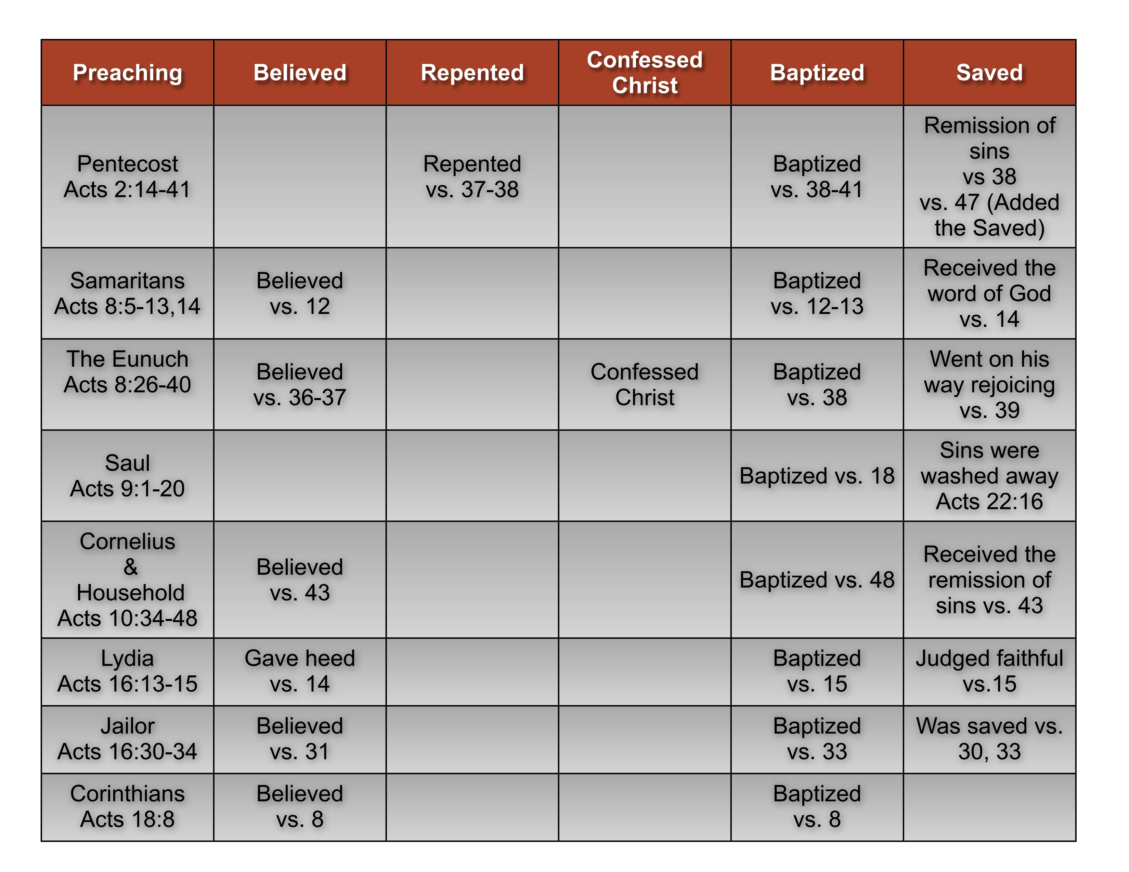

Slide 14
Have you obeyed god’s plan for your salvation?
Why Not NOW?

